Slide 1

AI Powered assistant for RedHat OpenShift
Shanmugakumar Manoharan

Slide 2
Agenda
What are intelligent apps?
Add AI to app and run on OpenShift
AI within Openshift
Takeaways
Q&A

Slide 3
What are intelligent apps?

Slide 4


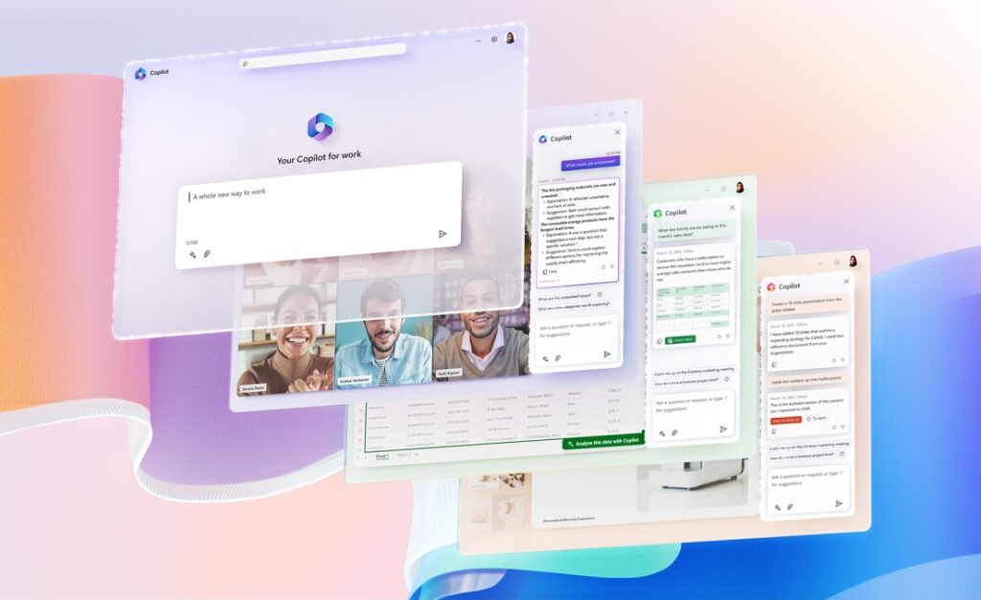
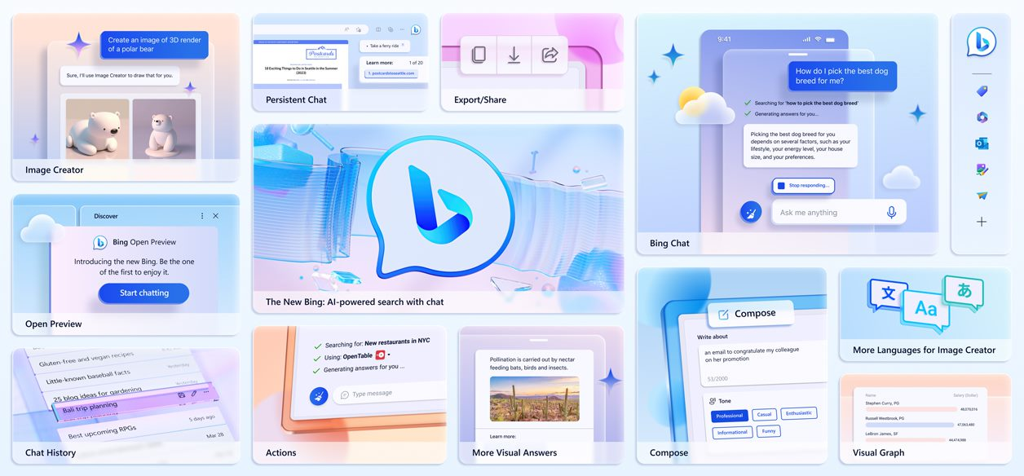

Chatbots and Copilots abound
AI is everywhere, AI in everything

Slide 5
Things to consider when building with AI…
6 core principles of responsible AI:
Privacy and security
Inclusiveness
Accountability
Transparency
Fairness
Reliability and safety
Prompting with frameworks and/or SDKs
Deploy with resiliency and scale in mind

Slide 6
AI in everything, everywhere, all at once...

Slide 7




OpenShift - Empowering you to differentiate
The full power of Kubernetes and the open-source ecosystem
A fully managed service to make it simpler and more productive
Guiding & bootstrapping your experience without abstracting
How can OpenShift and AI help you excel and make the most from Kubernetes?

Slide 8

OpenShift Copilot: AI-powered assistant for Kubernetes
Streamline your operations
Reduce your skilling efforts
Empower your developers
Available free for all clusters

Slide 9
Retrieval Augmented Generation
User Question
Workflow
Query My Data
Customized Open AI
Add Results to Prompt
Large Language Model Kubectl Plug-in
Query Model
Send Results

Slide 10
OpenShift Copilot: Core
Integrate OpenShift and Open AI build Intelligent System.
AI Powered Pair platform administration
AI Powered Troubleshooting
AI Powered Reasoning Engine for OpenShift Users
AI Powered Drift Detection

Slide 11
OpenShift Copilot: Use Cases
Trouble shooting the Defective PODS with Pre-Defined Models.
Interactive Pair Programming based on Context

Slide 12
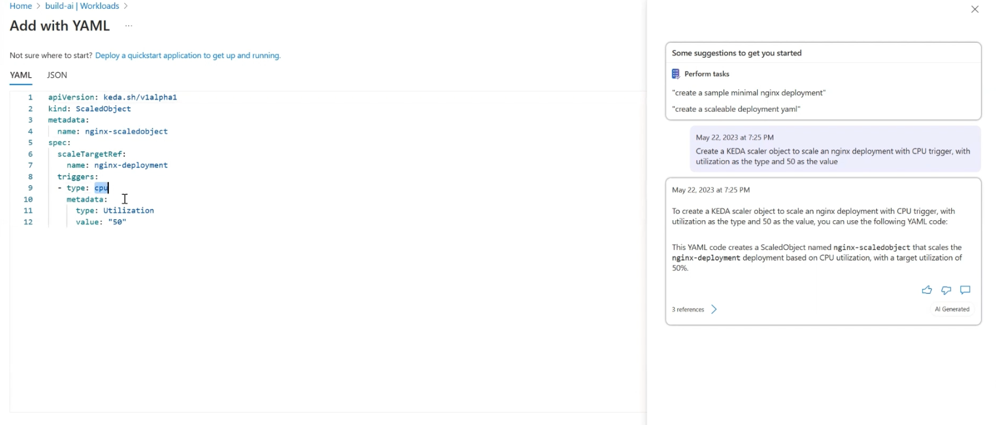
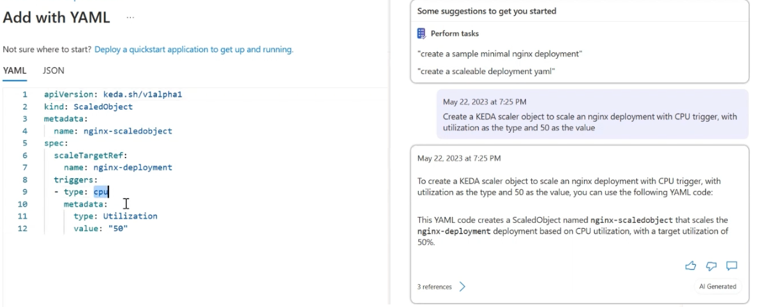
Samples 1 - Blueprint

Slide 13
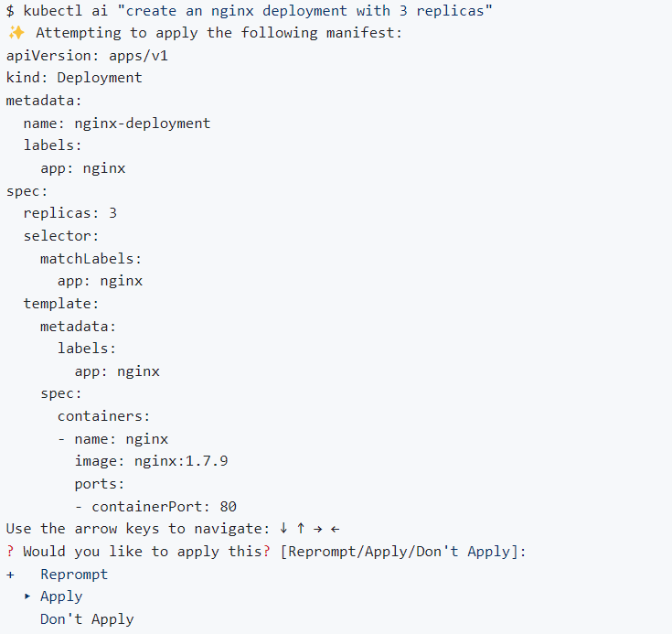
Samples 2 - Blueprint

Slide 14

Takeaways
AI is truly revolutionizing the way we think about apps
Run fast but don’t break things
Ship anti-fragile apps
AKS platform can help you operate at any scale

Slide 15
Q&A

Slide 16
Thank you!

Slide 17
Copyright Microsoft Corporation. All rights reserved.

Slide 18

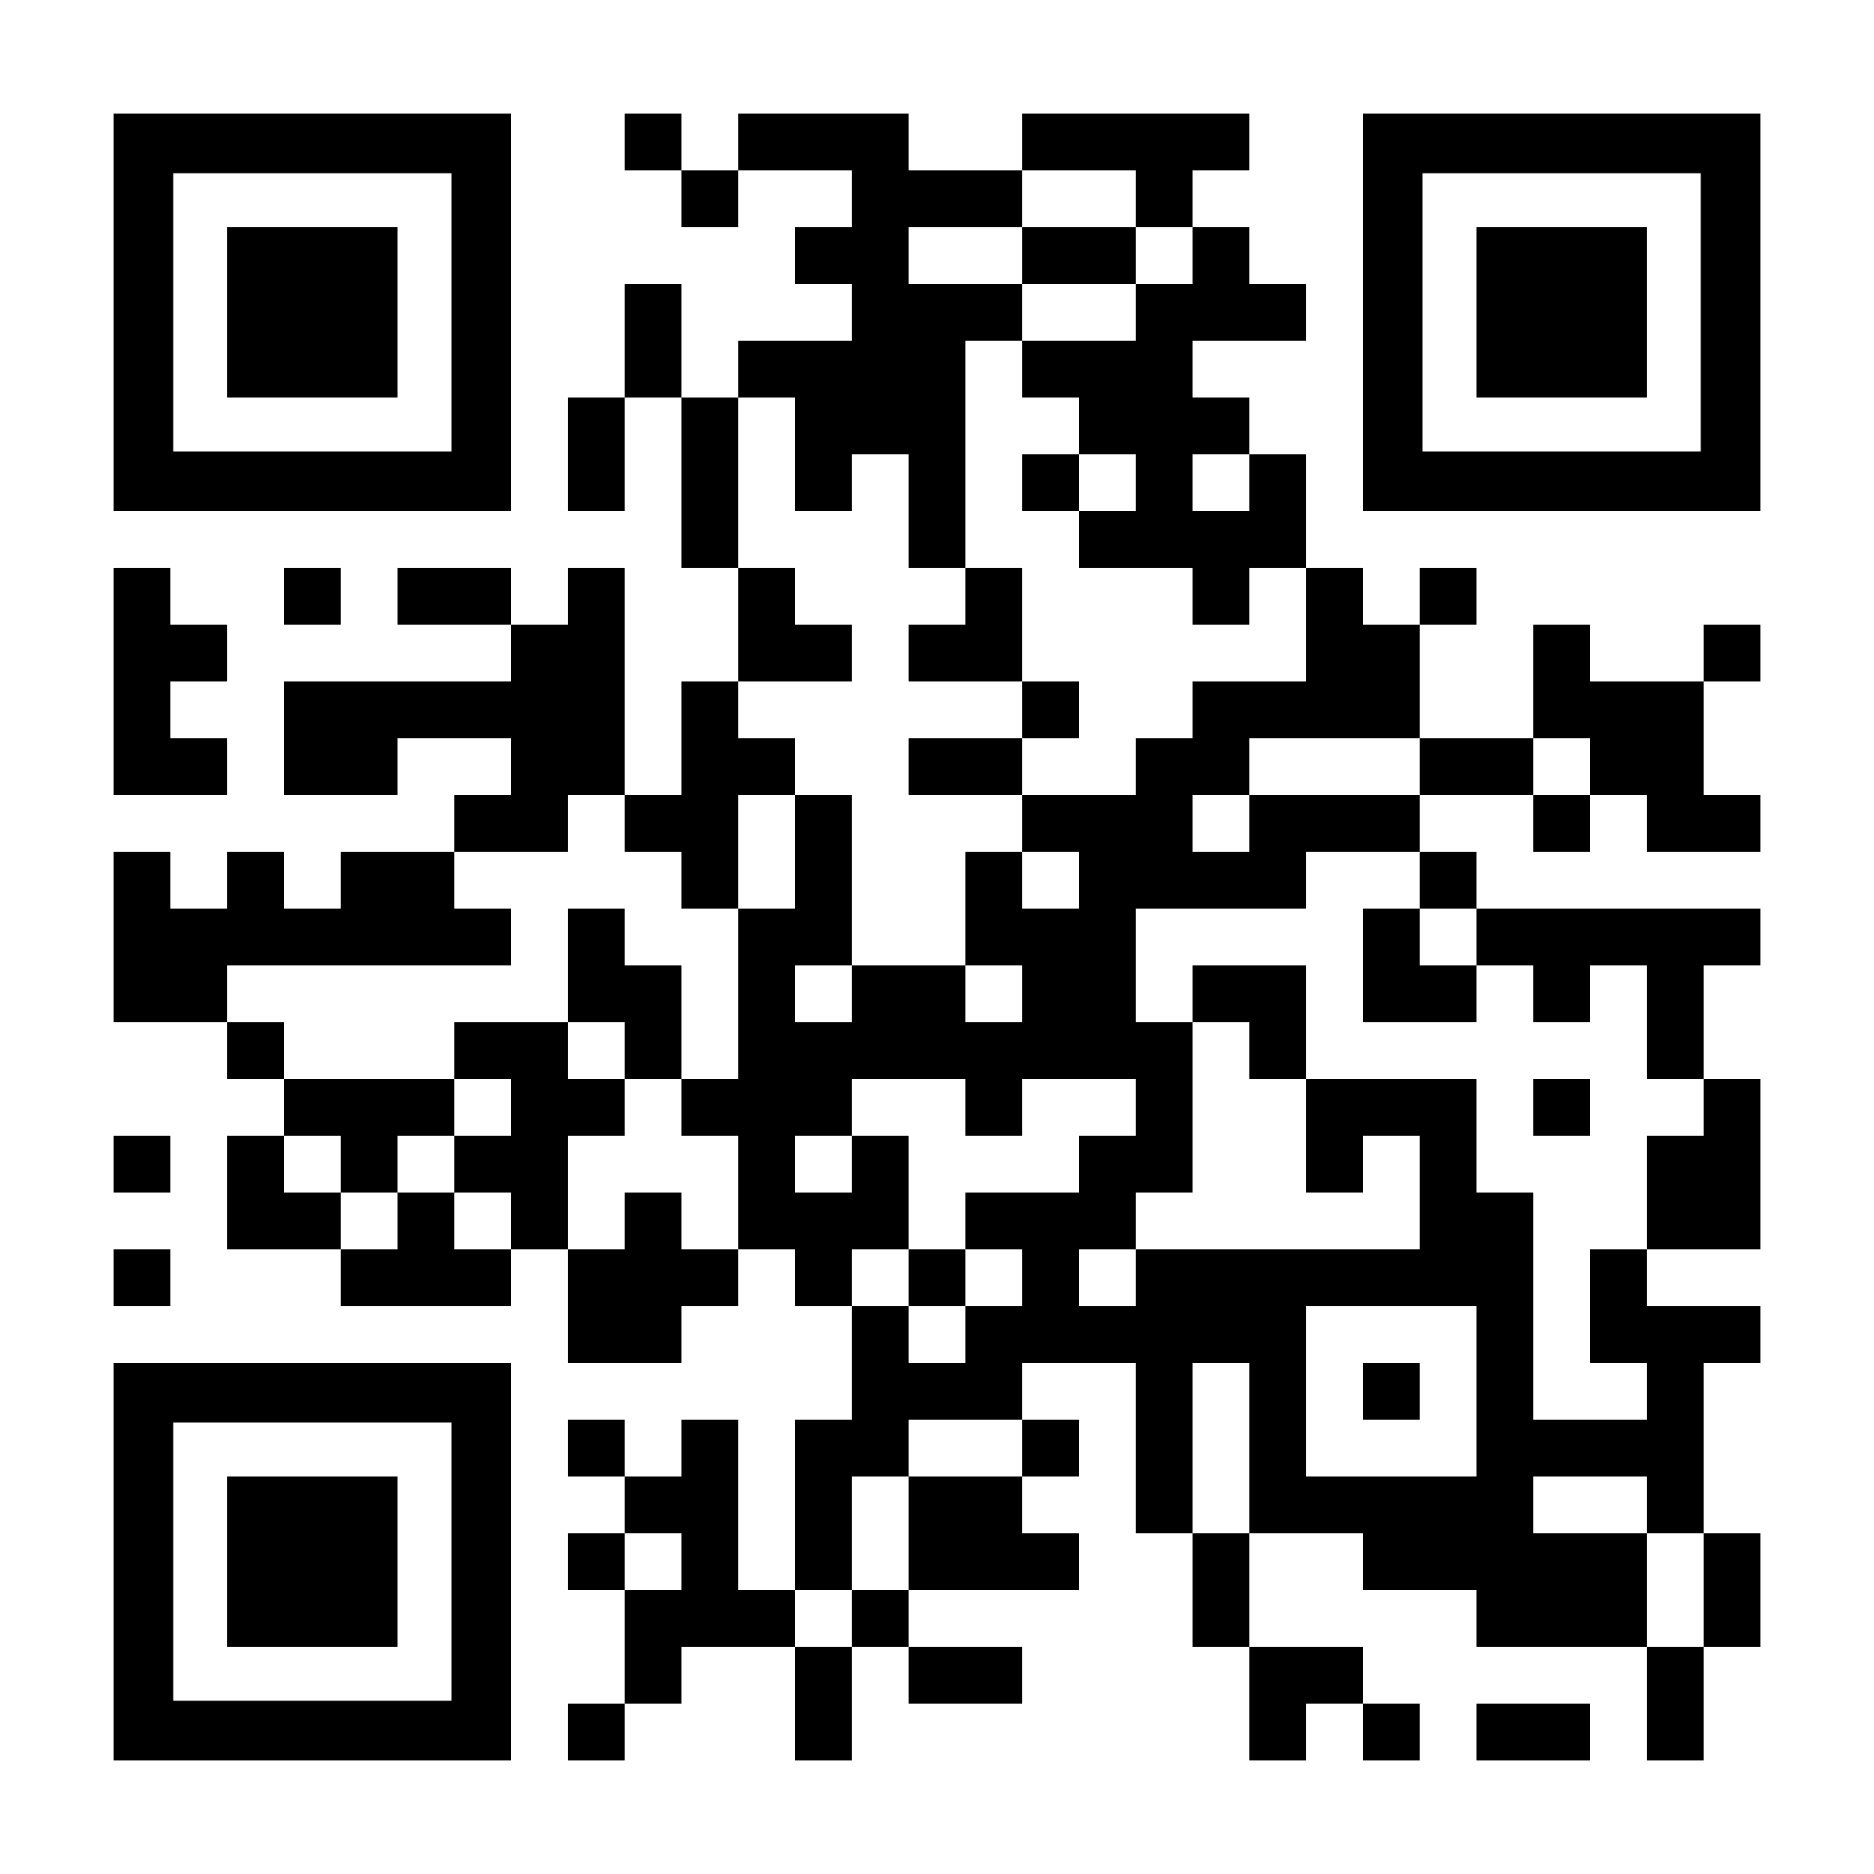
To ask questions during the session, join the chat!
aka.ms/build/room421

